Slide 1
Course Introduction
Welcome to ENGL 3110

Slide 2
Plan of Attack
  Quick Grade Check
  Review Exam Answers Together
  Brief Review of Adverbial Content
  Adverbial Homework

Slide 3
Test and Grades
110-100 (Amazing) – 7 Students
  High of 110 – 2 students
99-90 (Great) – 4 Students
89-80 (Very Good) – 3 students
79-70 (Acceptable) – 4 students
69 and Below (Needs Improvement) – 2 students
  Low of 68

Slide 4
Test and Grades
Points Remaining (380 pts)
  Exam Four – 100 pts
  Application Paper – 200 pts
  Two Quizzes – 40 pts
  Four Homeworks – 40 pts

Slide 5
Test and Grades
Grade Calculation
  Final Score of 940 needed for an A
  Estimates
  650 points or higher = On track for an A!
  600-650 = A is likely but do well and keep track
  Below 600 = A is in reach with work
    Consider some bonus, Aim to improve on Exam 4

Slide 6
Review
Familiar Adverbials
  Adverb Phrases
    Quite suddenly, he arose from the bed.
    She practices the violin rather ritualistically.
  Prepositional Phrases
    In the morning, I will journey to school.
    Juliet collapsed near Romeo’s body.
  Dependent Clauses
    As I was wandering, I spied a unicorn.
    I feel free because I quit my job.

Slide 7
Review
New Adverbials
  Noun Phrases as Adverbials
    Tomorrow, I will go to school.
    I get grumpy every Monday.
  Verb Phrases (Infinitives) as Adverbials
    To fund my hobbies, I started driving Doordash.
    I may be suffering just to appease my mother.
  Verb Phrases (Present Participles) as Adverbials
    The graduation ceremony was canceled, crushing all our dreams.
    Somewhat calming the situation, an apology was delivered.

Slide 8
Review
Identify the Adverbial Types in these Sentences
  One morning after my game, I ate an orange.
  To protect his plant, Bob bought some lady bugs.
  Steve climbed down the trellis, escaping her evil clutches.
  Drained of all energy, the cat curled up in the corner.

Slide 9
Review
Identify the Adverbial Types in these Sentences
  One morning after my game, I ate an orange.
    One morning after my game – Noun Phrase
  To protect his plant, Bob bought some ladybugs.
    “To protect his plant” - Infinitive Verb Phrase
  Steve climbed down the trellis, escaping her evil clutches.
    “escaping her evil clutches” – Present Participle Verb Phrase
  Drained of all energy, the cat curled up in the corner
    Drained of all energy – Past Participle Verb Phrase

Slide 10
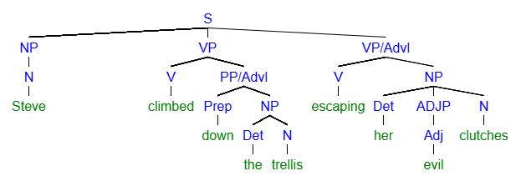
Review
Note: Some people might call this Adjectival – it’s debatable.

Slide 11
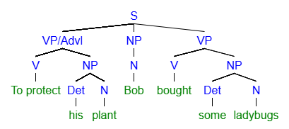
Review

Slide 12
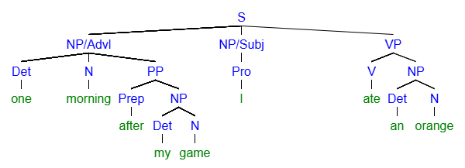
Review

Slide 13
Review
Homework Review

Slide 14
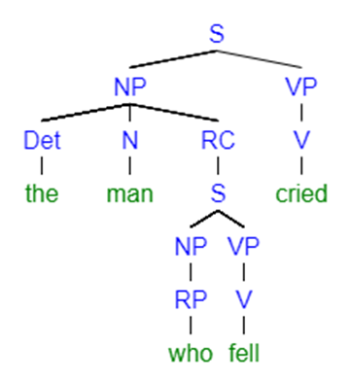
Relative Clause: Adjectival

Slide 15
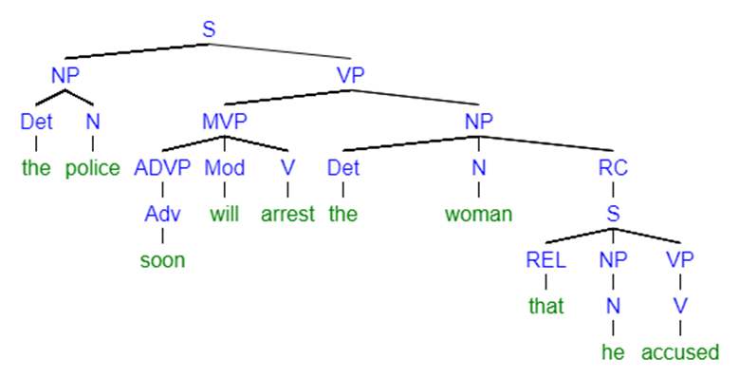
Relative Clause: Adjectival

Slide 16
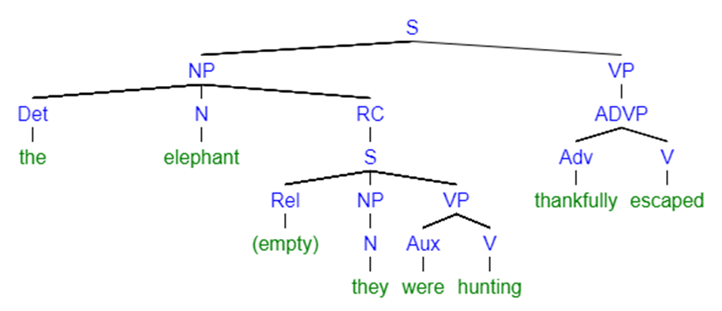
Relative Clause: Adjectival

Slide 17
End of Class
If you have questions or concerns, hang around to talk.

